Slide 1



PREDICTING CUSTOMER CONVERSIONS
IN INSURANCE SALES
CS 513 – B | GROUP NO - 09
TEAM MEMBERS
Supreeth Hassan Ravindra
20020533
Yash Deshpande
20025089
Thejesh Ravikumar
20021148

Slide 2

PROBLEM STATEMENT
Insurance Company
Employs multiple outreach plans to sell term insurance to the customers.
Telephonic marketing campaigns still remains one of the most effective ways to reach out to people.
However, they incur a lot of cost.

Slide 3
Challenge:
High costs associated with telephonic marketing campaigns necessitate targeted outreach.
Objective:
Build a machine learning model to predict customer subscription to term insurance.
Model Type:
Employ a classification model using Logistic regression and Random Forest to predict if a client will subscribe to insurance.

Slide 4
Cost Optimization
Identify customers with high conversion likelihood for focused telephonic campaigns.
Outcome
Enhance marketing efficiency, reduce costs, and increase subscription rates through targeted outreach.
Data Utilization
Analyze historical marketing data, including customer demographics and
past interactions.

Slide 5
FEATURES
age (numeric)
job: type of job
marital: marital status
educational_qual: education status (primary, secondary or tertiary)
call_type: contact communication type
day: last contact day of the month (numeric)
mon: last contact month of the year
dur: last contact duration, in seconds (numeric)
num_calls: number of contacts performed during this campaign and for this client
prev_outcome: outcome of the previous marketing campaign (categorical: "unknown","other","failure","success")
Output variable (desired target): y - has the client subscribed to the insurance? (yes/no)

Slide 6
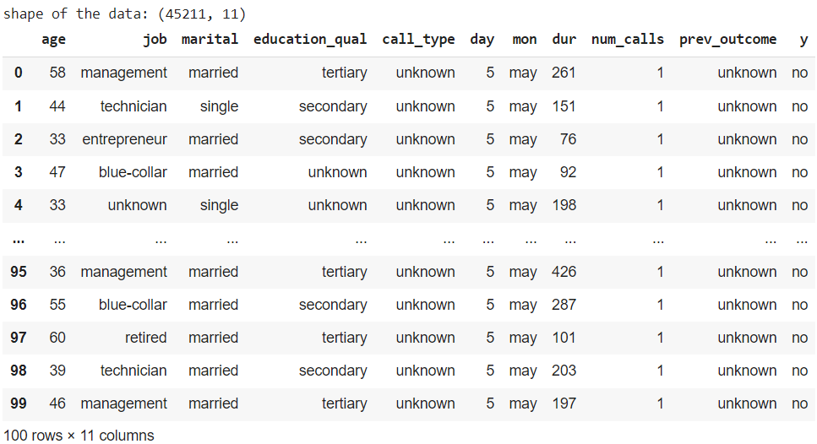
LOADING THE DATASET AND DATA CLEANING

Slide 7
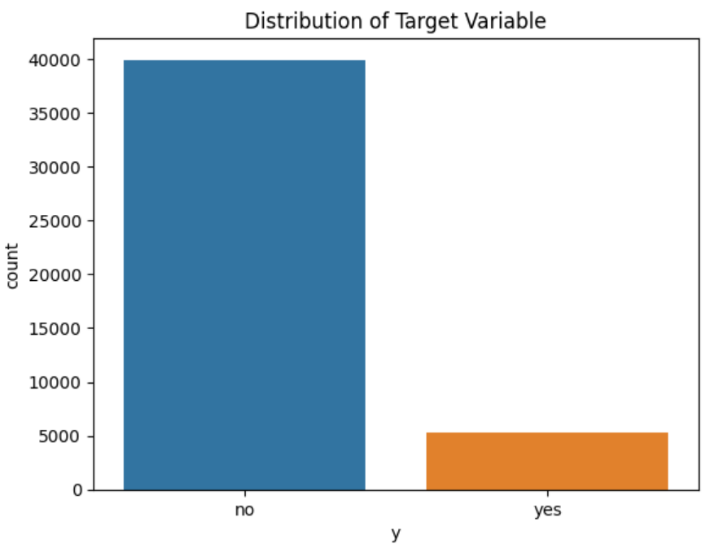
EXPLORATORY DATA ANALAYSIS
Involves in exploring and analyzing the relevant data to gain valuable insights.
Visualizing the distribution of the categorical data using the count plot.
Calculating the percentage of the target variable.

Slide 8
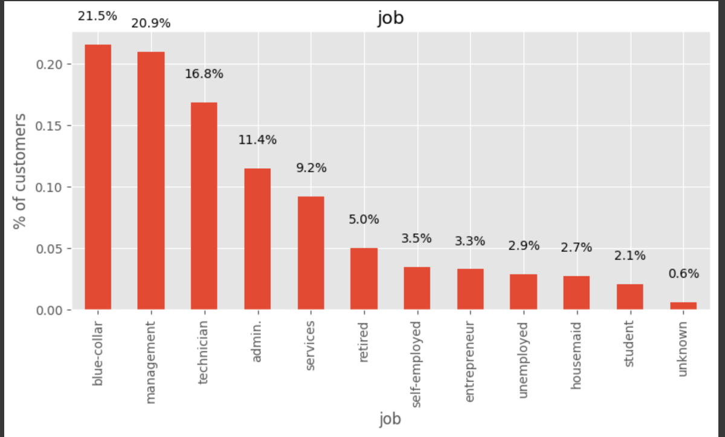
UNIVARIATE ANALYSIS – CATEGORICAL VARIBALE
Used to separate the categorical variables and numerical variables.
Analyzing a single variable at a time using the bar plot.
Visualizing the proportions of different categories within each variable.
Grammar of Graphics(ggplot).

Slide 9
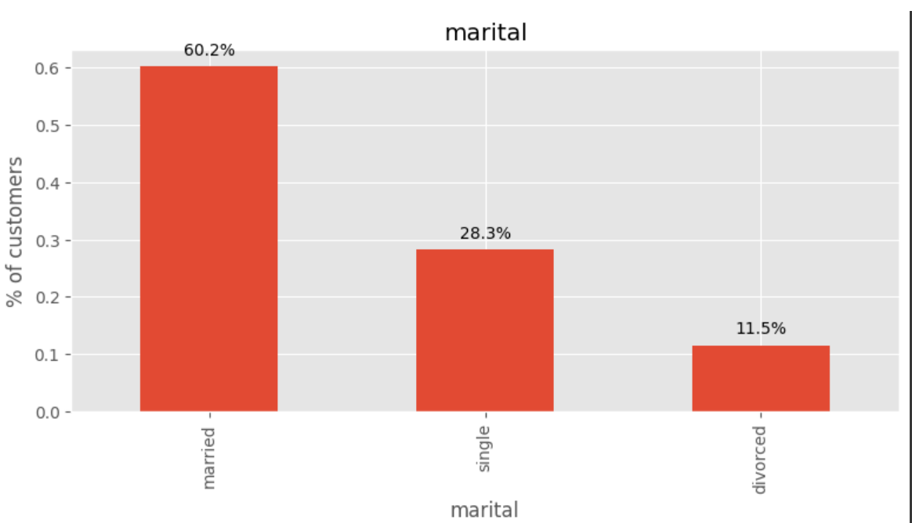
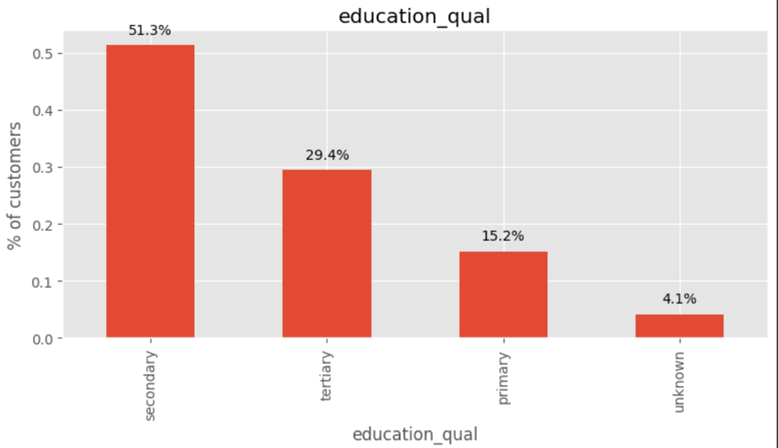
SCREENSHOTS

Slide 10
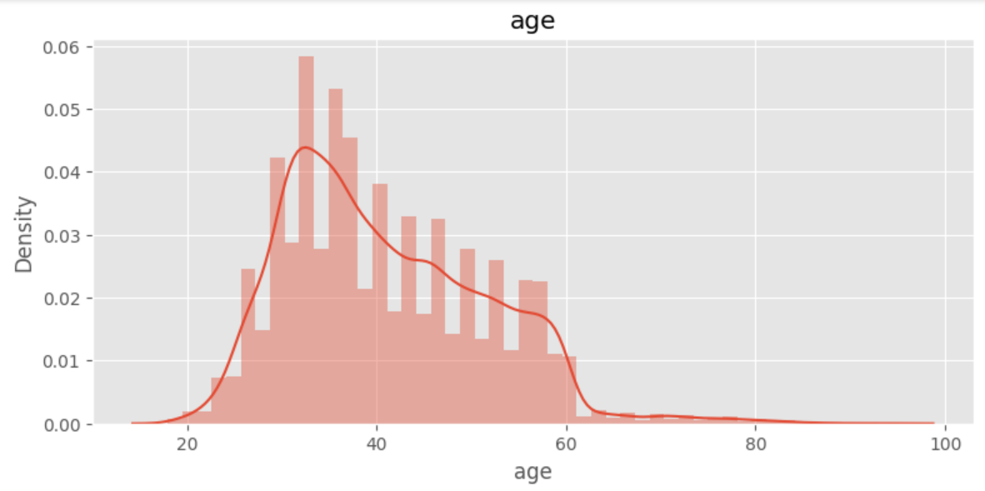
UNIVARIATE ANALYSIS – NUMERICAL COLUMNS
Estimation of numerical variable using the histogram plot.
Examining and analyzing the individual numerical variable at a time.

Slide 11
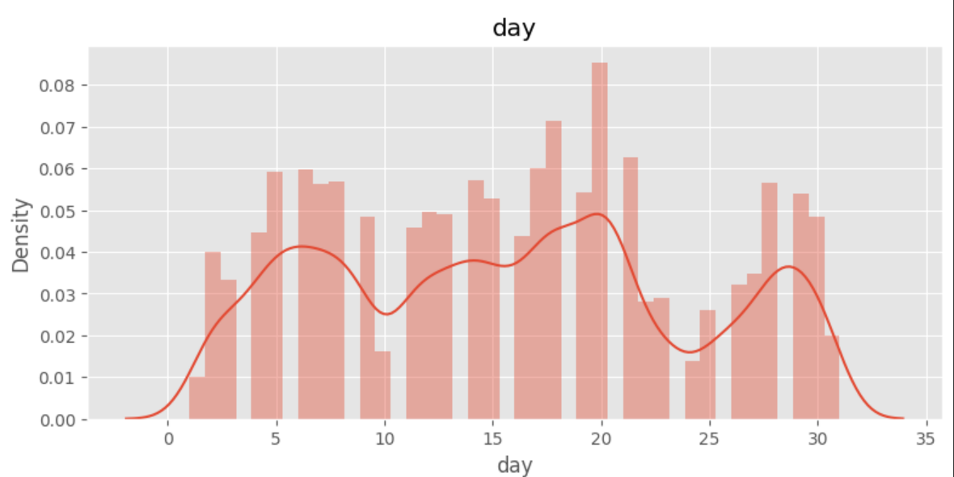
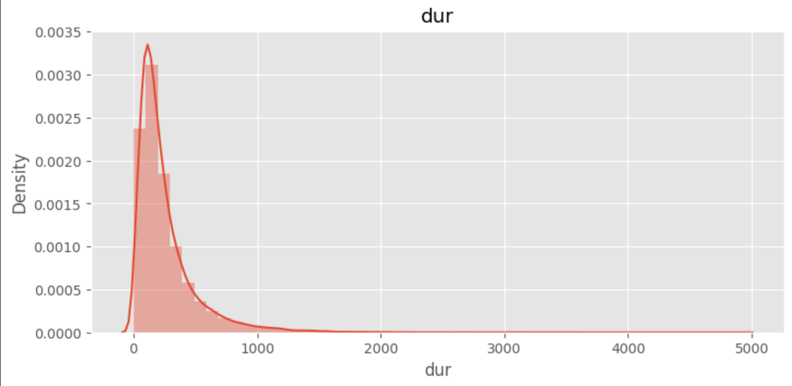
SCREENSHOTS

Slide 12
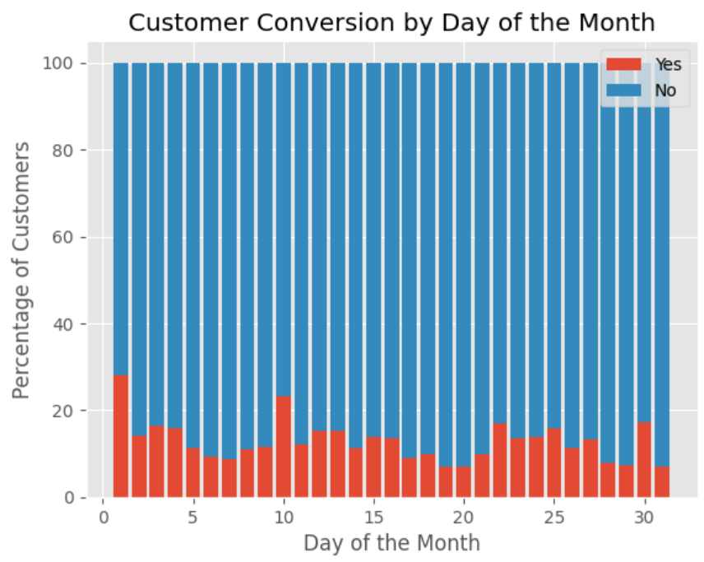
Distributing customer conversion
(yes and no) on each day of the month.
Visualizing the customer conversions across different days using the stacked bar chart.

Slide 13
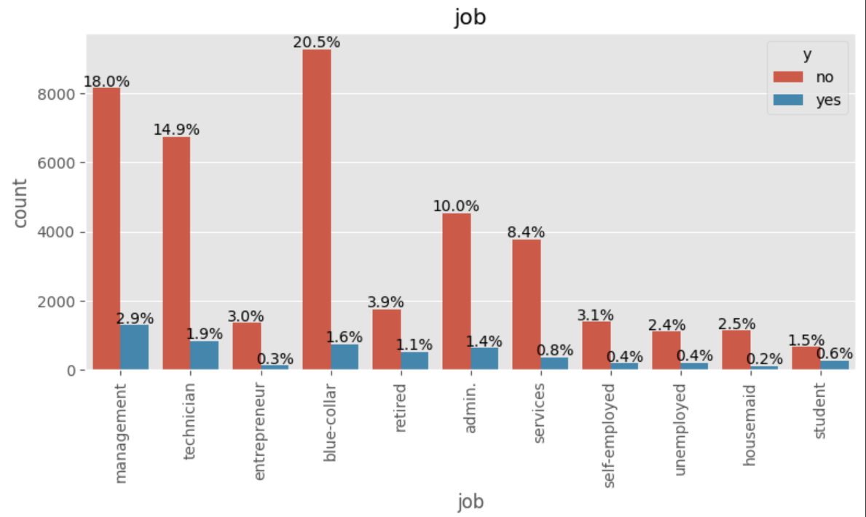
BIVARIATE ANALYSIS - CATEGORICAL COLUMNS
Analyzing two variables simultaneously to understand the relationship.
Calculating the percentage of each variable.

Slide 14
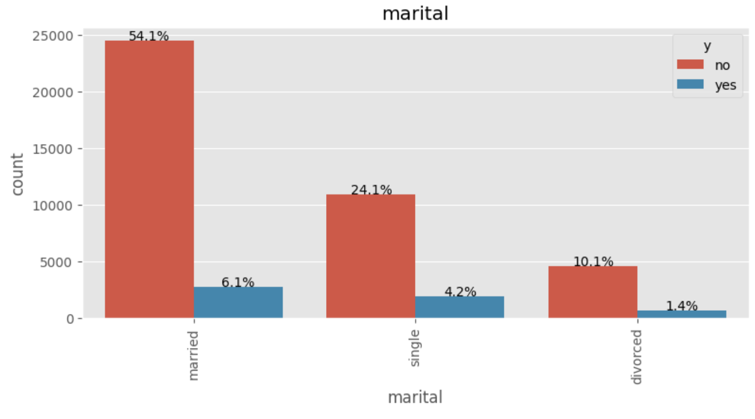
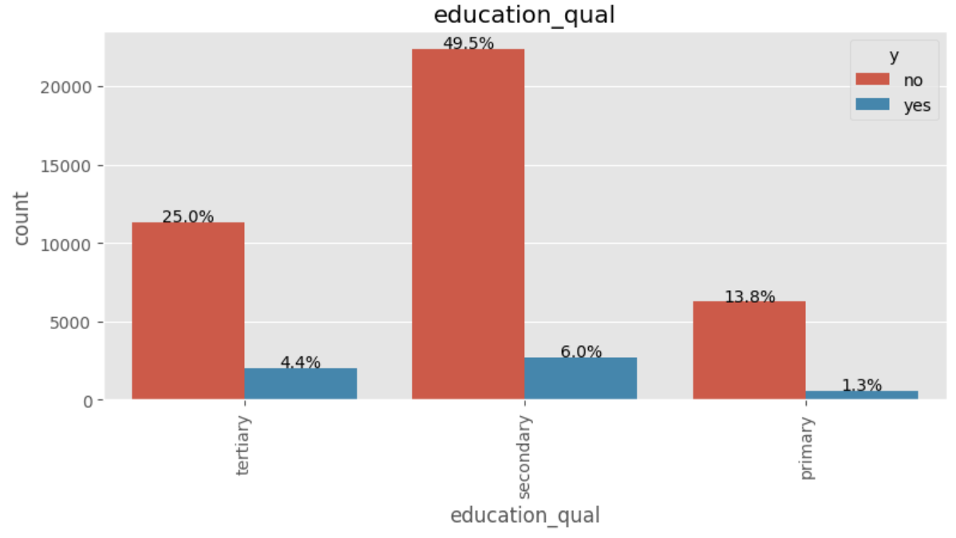
SCREENSHOTS

Slide 15
HANDLING OUTLIERS
Outliers are the data points that deviate significantly from the rest of the data.
Lower and Upper boundaries – Used to identify the potential outliers.
Above or below the boundaries are identified as potential outliers.

Slide 16
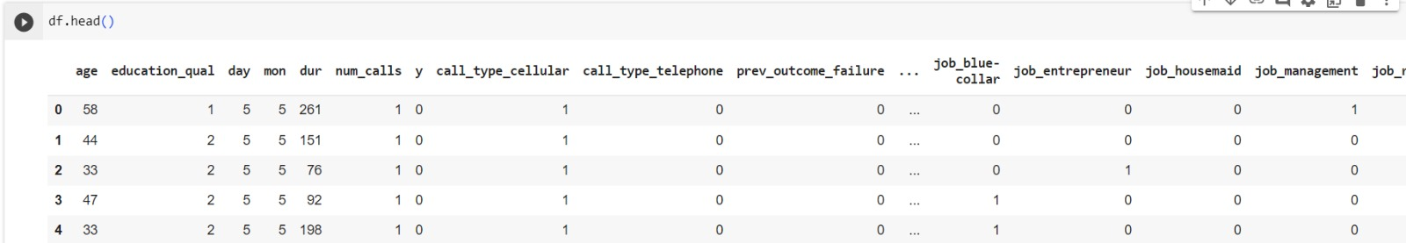
ENCODING CATEGORICAL FEATURES
One hot encoding converts categorical variables into numeric values
In our dataset, the Education Qualification column is represented as
Tertiary as 1, Secondary as 2, Primary as 3
Other columns encoded-
Months
Call_type
Prev_outcome
Marital
Job

Slide 17
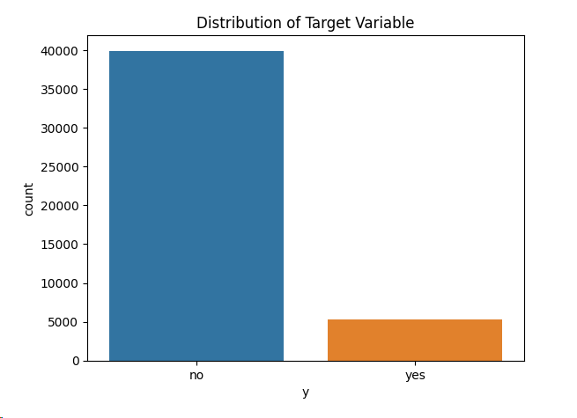
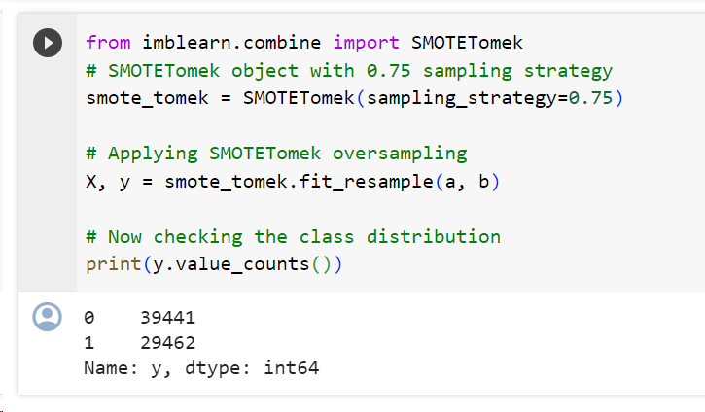
HANDLING IMBALANCED DATASET
In this dataset’s target variable
Yes samples are 11.7 %
No samples are 88.29%
Used Synthetic Minority Oversampling
(SMOTE) for balancing the dataset
After oversampling
Yes Samples are 39398
No Samples are 29419
Scaled the data using Standard Scaler

Slide 18
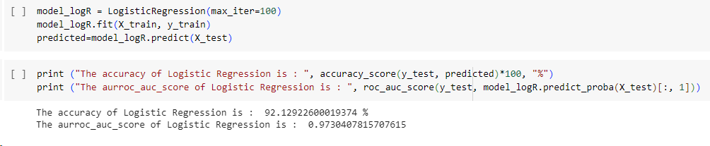
LOGISTIC REGRESSION
Logistic regression predicts a dependent data variable by analyzing the relationship between one or more existing independent variables
Three types-
a) Binary Logistic Regression - Only 2 possible outcomes
b) Multinomial Logistic Regression - 3 or more than 3 outcomes
c) Ordinal Logistic Regression- 3 or more than 3 possible outcomes in a proper order
c
Here, we are predicting whether the person is getting converted to customer or not

Slide 19
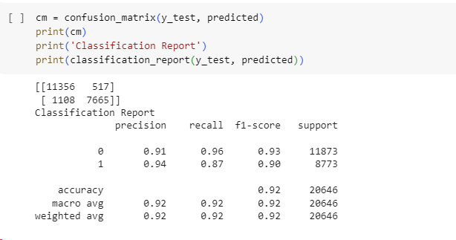
LOGISTIC REGRESSION

Slide 20
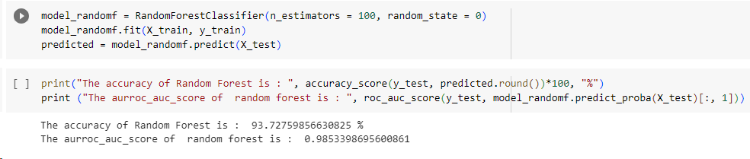
RANDOM FOREST
Random Forest consists of many Decision Trees
Establishes outcome based on predictions of Decision Trees
Takes average or mean of output from various trees
Solves the issue of overfitting in Decision Trees
Provides a higher level of accuracy in predicting outcomes

Slide 21
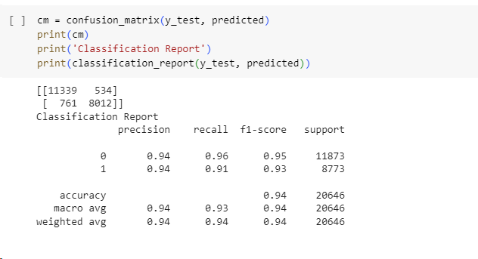
RANDOM FOREST

Slide 22
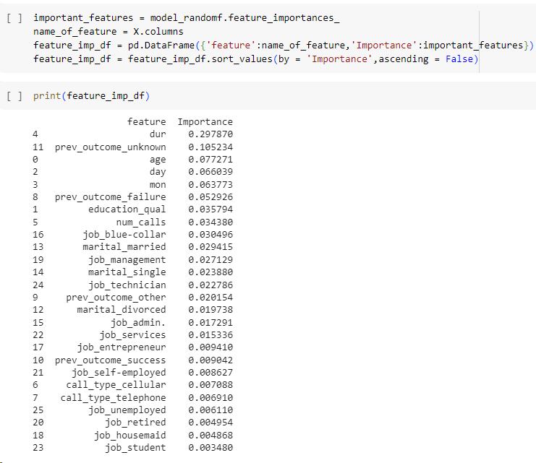
CONCLUSION
Based on outcomes given by model, Call Duration is the most important feature
Higher the duration of call, higher are the chances of a person getting converted to a customer

Slide 23
THANK YOU

